Slide 1

Mission Statement
To provide safe drinking water through a dependable water system to the community of Arvin with a commitment to Customer Service and Cost Efficiency.
Regular Meeting Agenda for the Board of Directors
Monday, October 2, 2020

Slide 2
1. Public Comment
This meeting is held in accordance with the Brown Act. Individuals may address the Board on any matter listed on this agenda, excluding closed session. Members of the public desiring to address the Board must request recognition from the Board President. Presentation by members of the public is limited to two minutes each per agenda item.
This portion of the meeting is set aside for members of the public to address any matter not on this agenda and over which the Board has jurisdiction. Comments are limited to 2 minutes for each person and 15 minutes on each subject.

Slide 3
2. Consent Calendar
a. Approval of Minutes for Regular Meeting September 21, 2020
b. Accounts Payable for Sept/Oct 2020

Slide 4
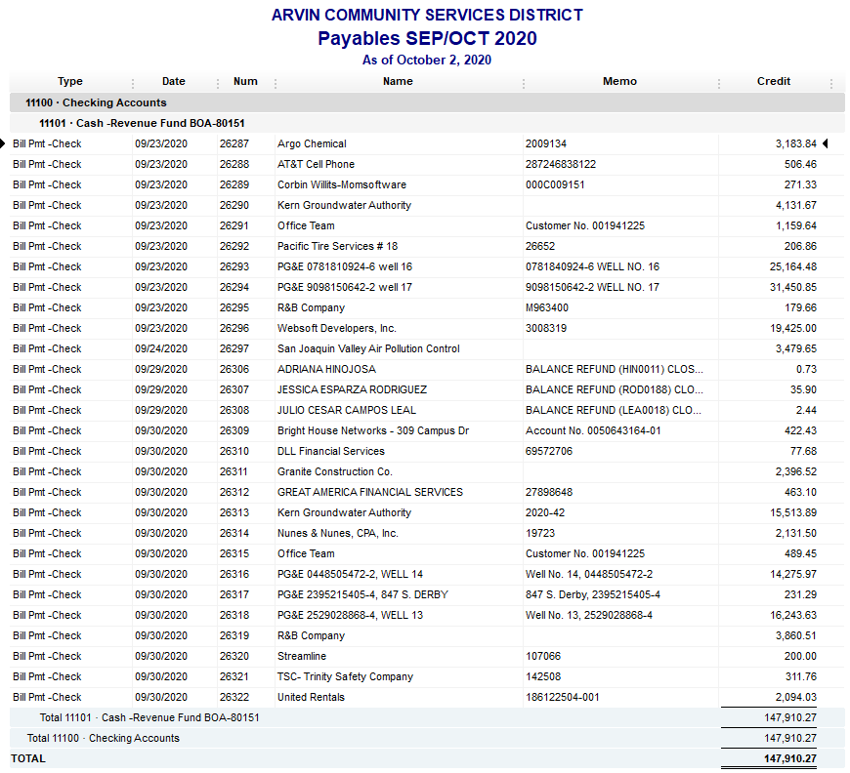

Slide 5
3. Board to discuss and take action re: Initial steps to dispose of surplus well sites

Slide 6
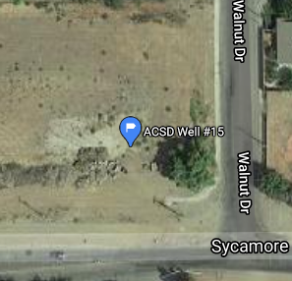
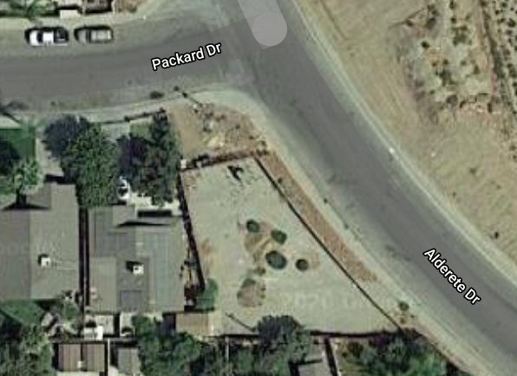
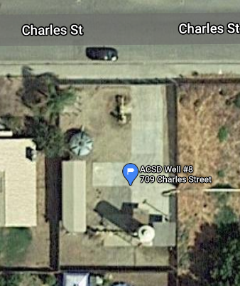
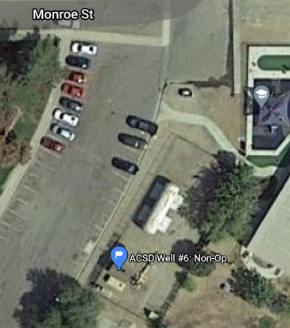
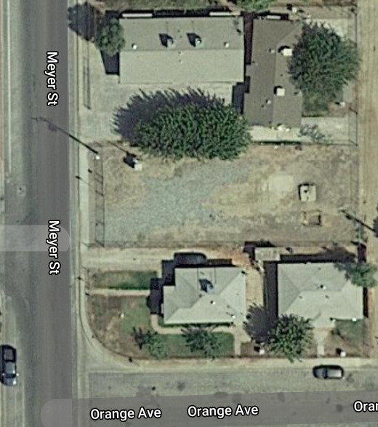
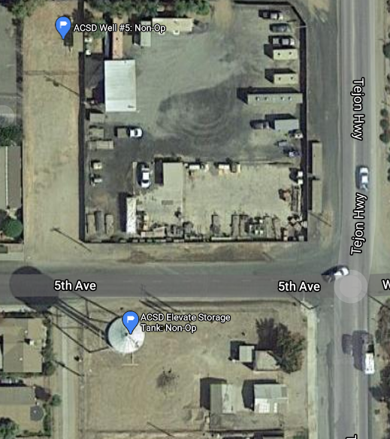

Slide 7
4. Board to discuss and take action re: Elevated Tank Removal

Slide 8
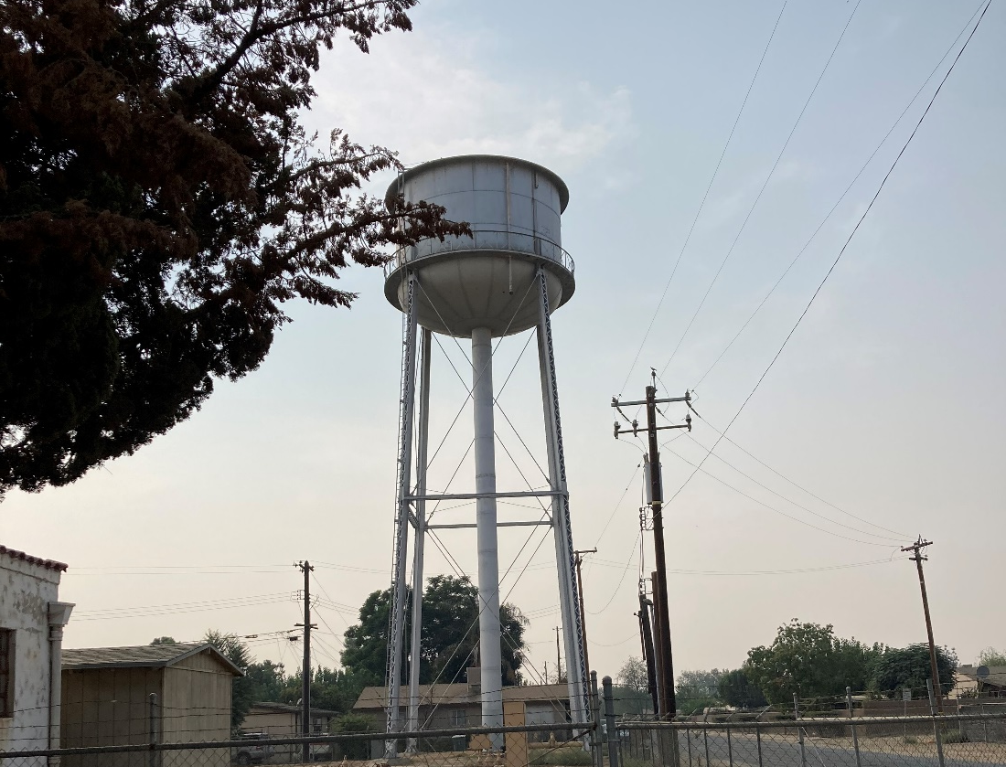
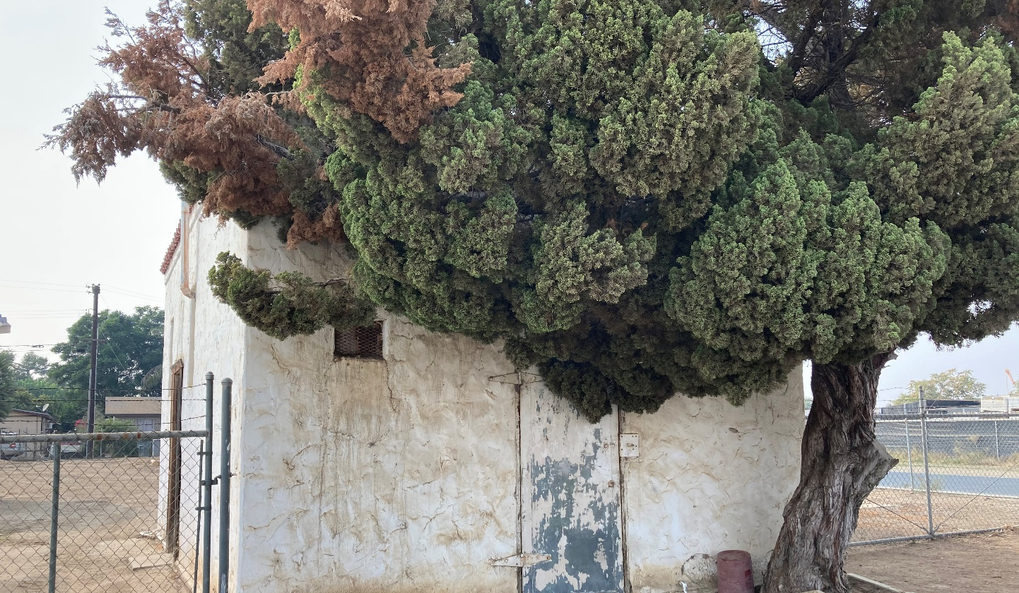
Elevation Tank
70,000 Gallons
Out of Service since May 17, 2016
Estimate to remove tank about $75,000
Arvin Jail House (city

Slide 9
5. Project Updates
a. Arsenic Mitigation Project Phase II
b. EPA Replacement Well No. 12
c. Xpress Bill Pay (online payment)

Slide 10
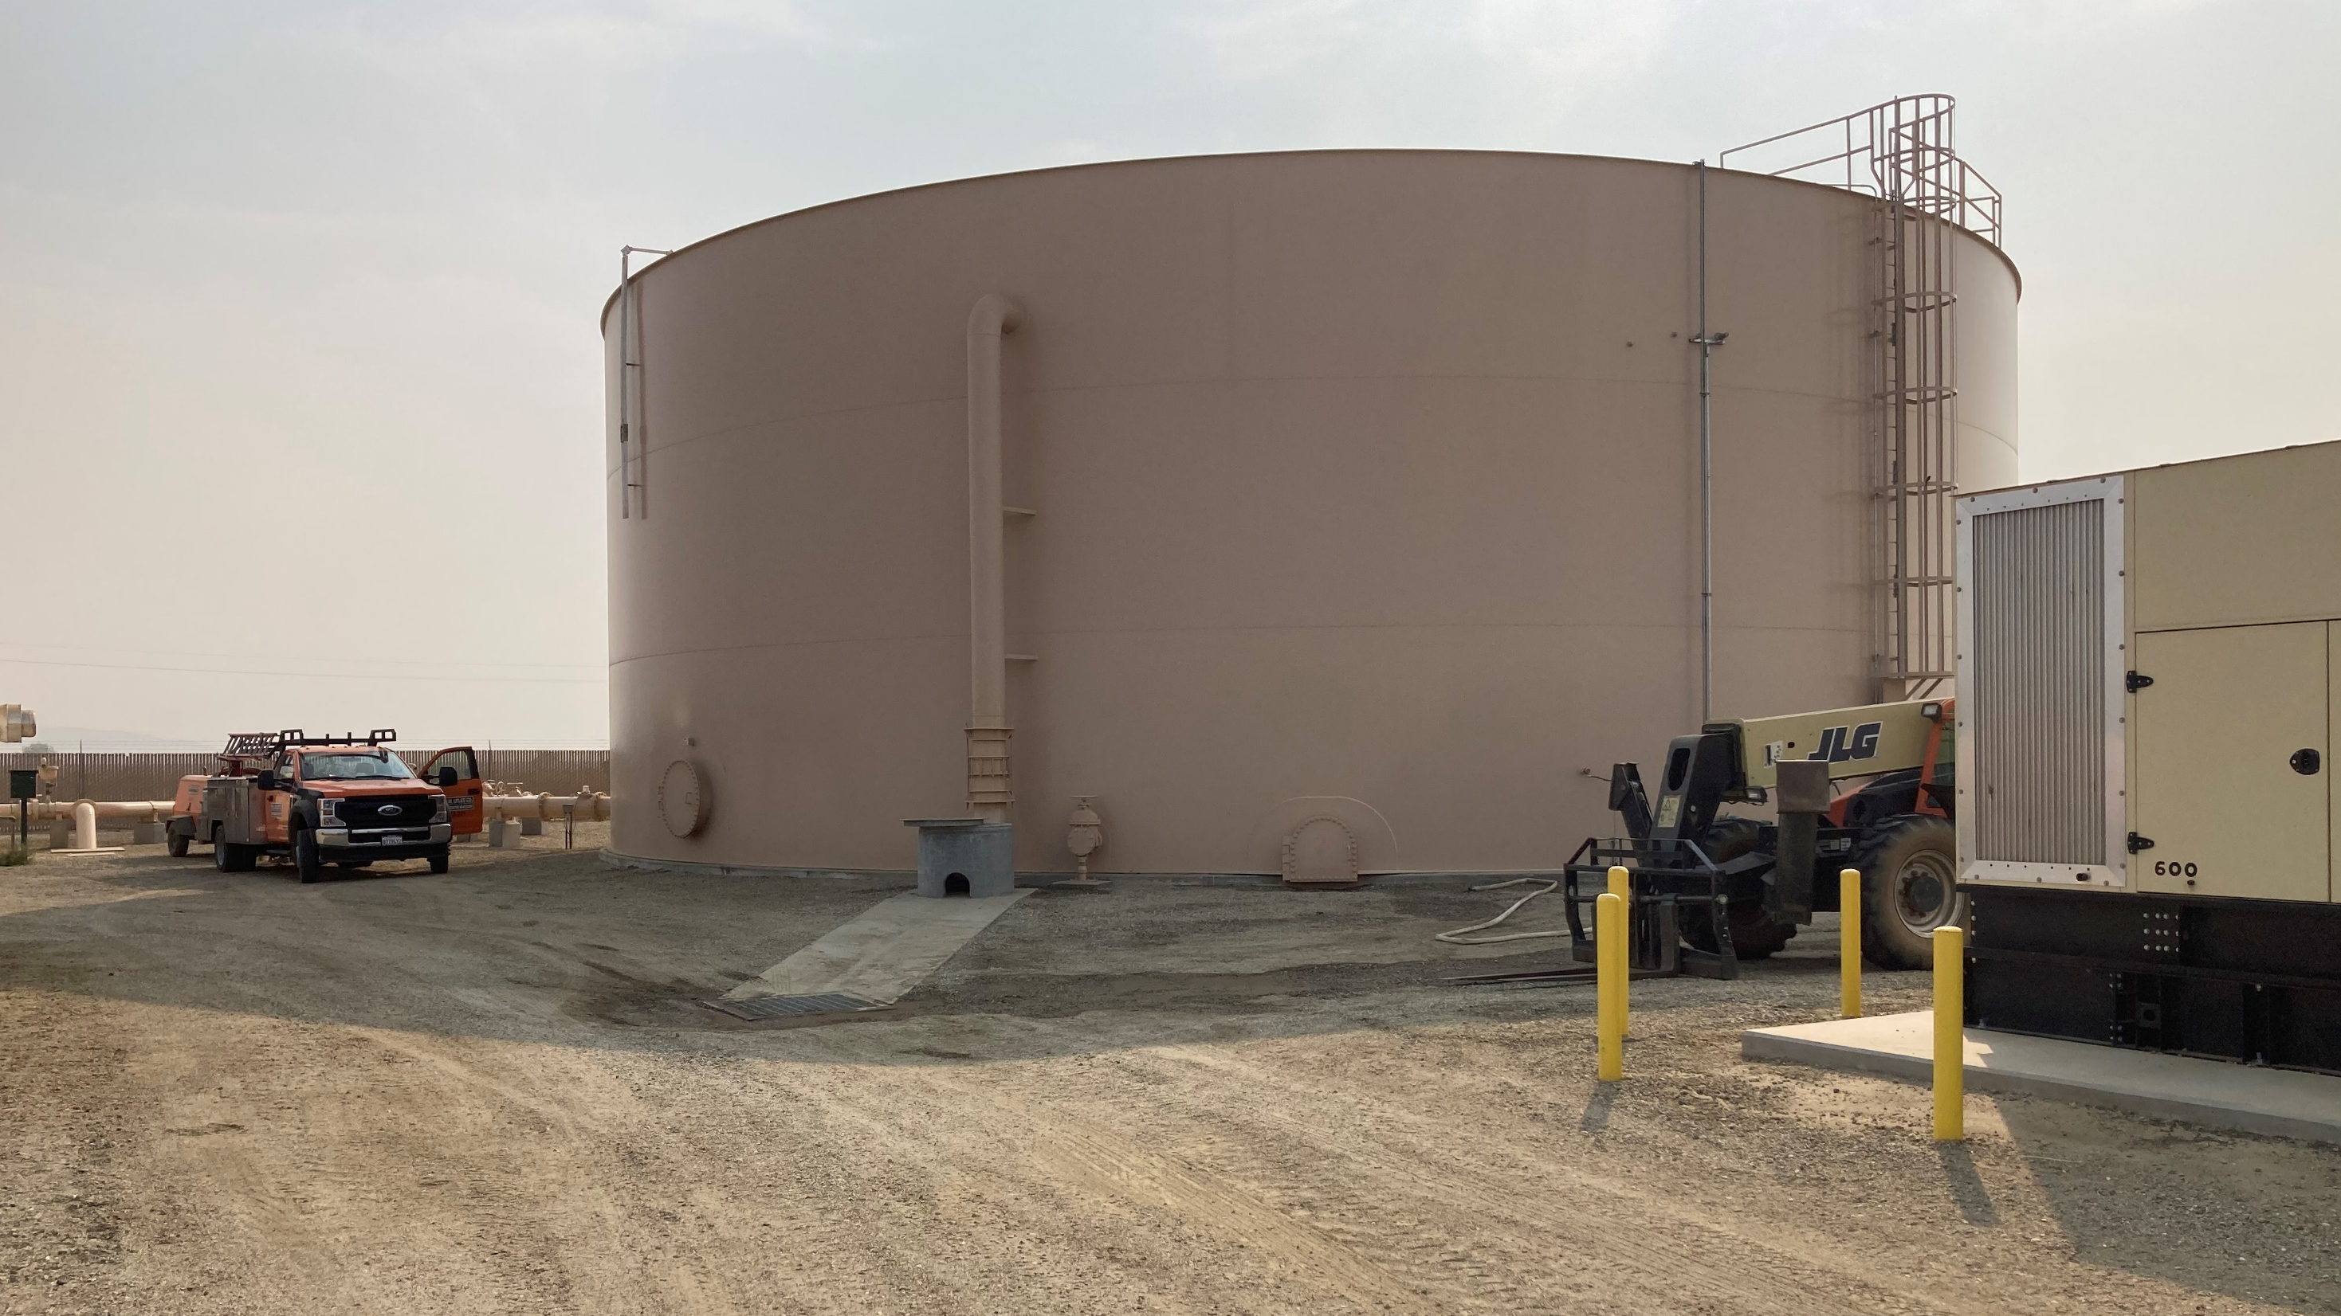
a) Arsenic Mitigation Project Phase II

Slide 11
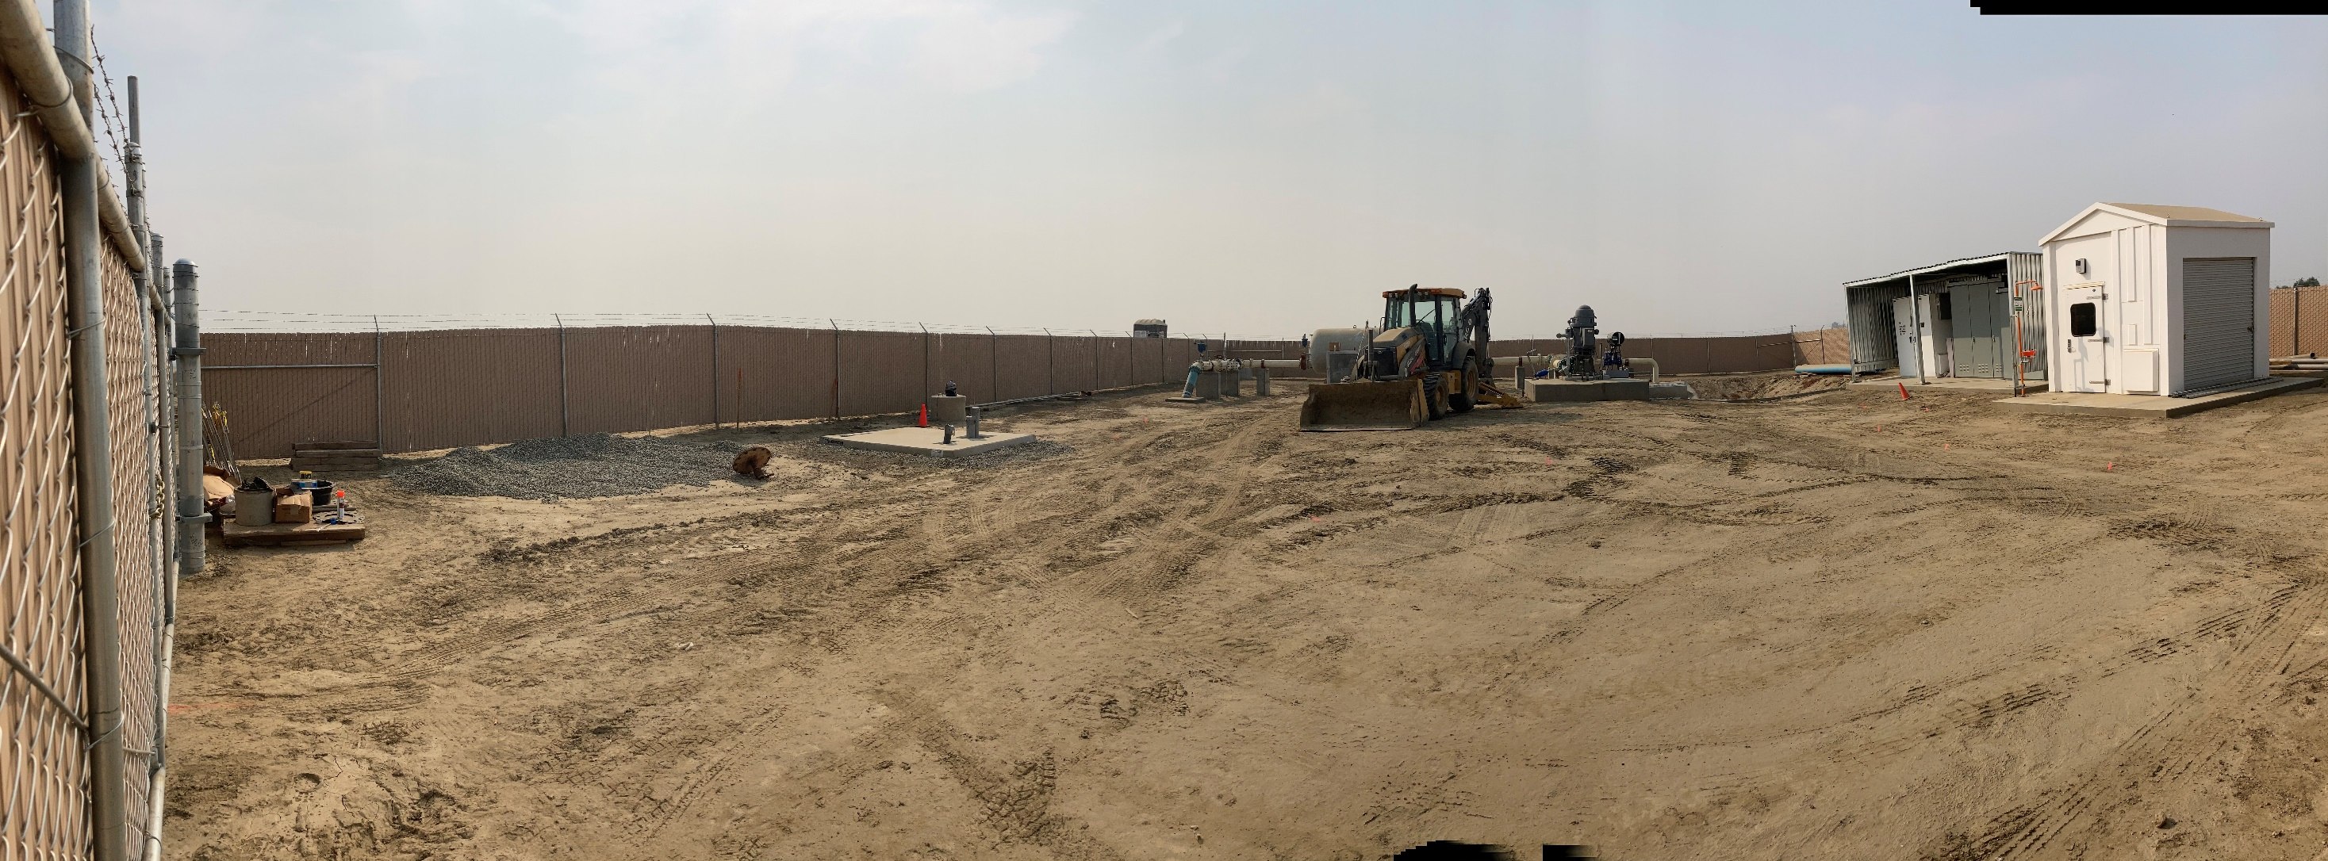
b) EPA Replacement Well No. 12

Slide 12
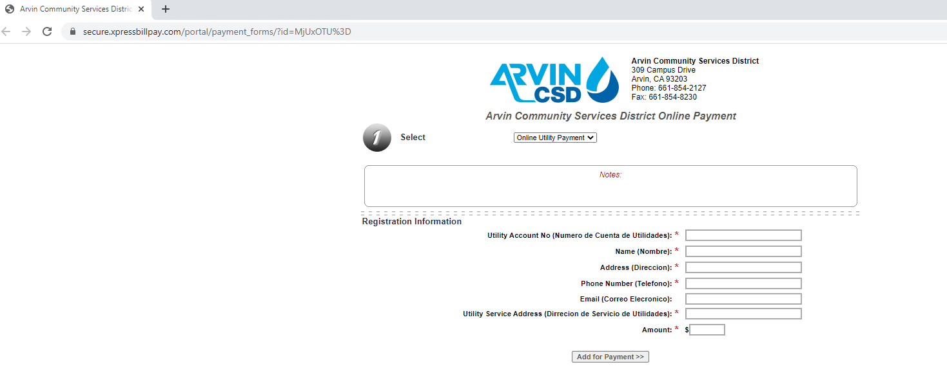
c) Xpress Bill Pay (online payments)

Slide 13
6. Staff Comments
General Manager Raul Barraza, Jr.
Legal Counsel Alan J. Peake
District Engineer Dee Jaspar

Slide 14
7. Board Director Comments
Board Director Rodriguez
Board Director Reyna
Board Director Moran
Board Director Alvarez
Board Director Gallardo

Slide 15
8. Adjournment
Next Meeting Dates:
Monday, October 19th
Monday, November 2nd
Monday, November 16th

